Slide 1
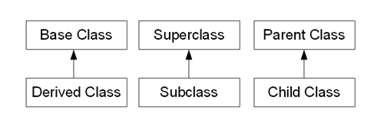
Inheritance using Java
Terms
  source: http://www.learn-java-tutorial.com/Java-Inheritance.cfm
Java Programming Guidelines

Slide 2
Why inheritance?
to model hierarchies found in the real world
to allow customization for some features, and have some features that are common to all
Also helpful with maintenance
  old code depends on base class
  specializations are made derived classes and distributed
  Example: if code is written for Fruit then it will work for Apple now, and any other fruit instance that is added in the future
Java Programming Guidelines

Slide 3
inheritance example
class BaseClass {
private int baseX;
public int f();
protected int baseG() { …}
public BaseClass(int baseXin) { …} // constructor
}
class DerivedClass extends BaseClass {
private int derY;
public int f() { // overridden implementation }
public void derivedGG() { derY = baseG(); }
// Note: baseX variable is NOT accessible in this class
}
Java Programming Guidelines

Slide 4
Access for Protected
A protected field or method is visible to a derived class of the base class.
A protected field also means that all classes in the same package can also access it.
Package private:
  If no modifier is used, only classes in the same package can use it
Java Programming Guidelines

Slide 5
inheritance example: using super
class DerivedClass extends BaseClass {
private int derY;
DerivedClass(int xIn, derYIn ) {
super (xIn);
derY = derYin;
}
…
}
In a class constructor you can reuse the superclass constructor and overridden superclass methods by using the reserved word super.
this reference to superclass constructor must be the first line of code in the subclass constructor.
Java Programming Guidelines

Slide 6
Abstract method in a Superclass
class DerivedClass {
private int derY;
DerivedClass(int yIn, derYIn ) {
super (yIn);
derY = derYin;
}
void commonWork() { ….}
abstract void doComplexWork();
…
}
If a method is abstract, the entire class is abstract
Java Programming Guidelines

Slide 7
Abstract Superclass
abstract class DerivedClass {
private int derY;
DerivedClass(int yIn, derYIn ) {
super (yIn);
derY = derYin;
}
void commonWork() { ….}
abstract void doComplexWork();
…
}
If a class is declared abstract, the entire class is abstract
Java Programming Guidelines

Slide 8
Abstract class vs Abstract method
Abstract class
  may or may not have abstract methods
  can have concrete methods
  are incomplete by themselves and need to be completed by a subclass
  cannot be instantiated
Abstract method
  Has no definition in the class
  Has to be implemented in a derived class
Java Programming Guidelines

Slide 9
Superclass is generic
a derived class instance can be used in any place a base class instance is expected
  as a variable, a return value, or argument to a method
derived classes can change the behavior of existing methods (which is called overriding the methods)
The superclass is supposed to be more general than its subclass(es).
  as it contains elements and properties common to all of the subclasses.
Java Programming Guidelines

